Slide 1
Tangent ratio
Trigonometry

Slide 2
How our teaching resources are designed for the classroom

Slide 3
I can derive the tangent ratio from the sides of a right-angled triangle.

Slide 4
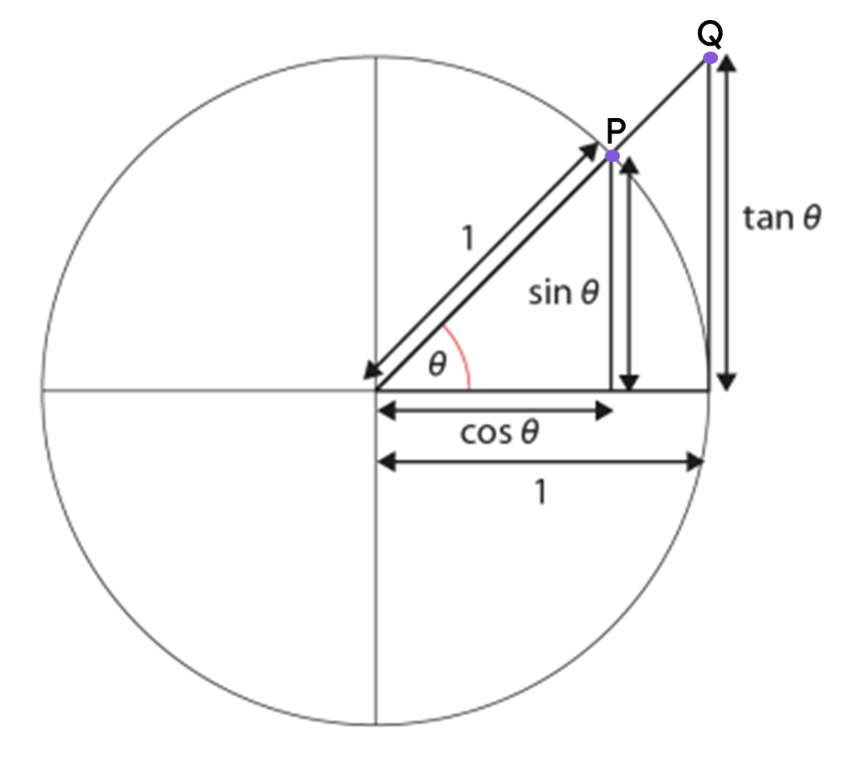
The adjacent side of a right-angled triangle is the side which is next to both the right angle and the marked angle.
The opposite side of a right-angled triangle is the side which is opposite the marked angle.
The trigonometric ratios are ratios between each pair of lengths in a right-angled triangle.
The tangent of an angle (tan(θ°)) is the y-coordinate of point Q on the triangle which extends from the unit circle.

Slide 5

Tangent ratio
Ratio tables, the unit circle, and tangents
The opposite and the adjacent
Effectively using a calculator for the tan ratio

Slide 6
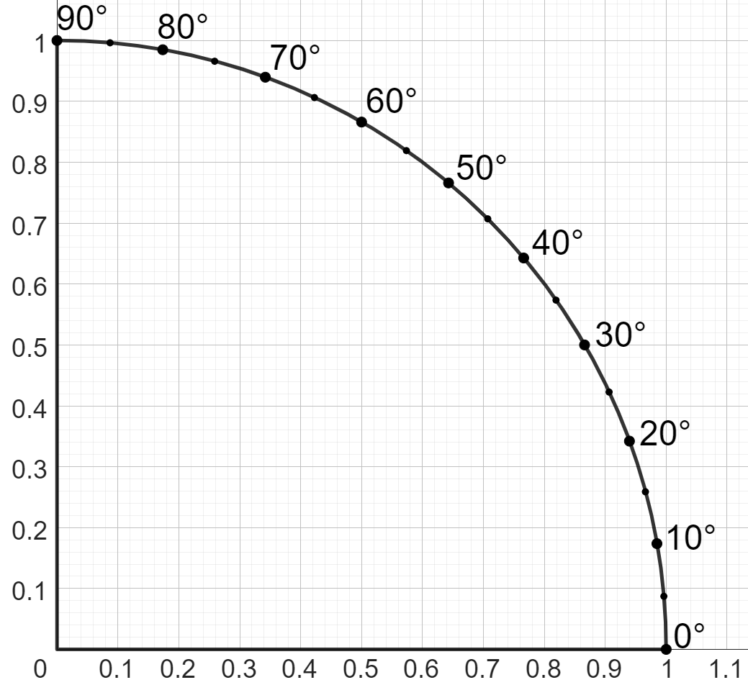
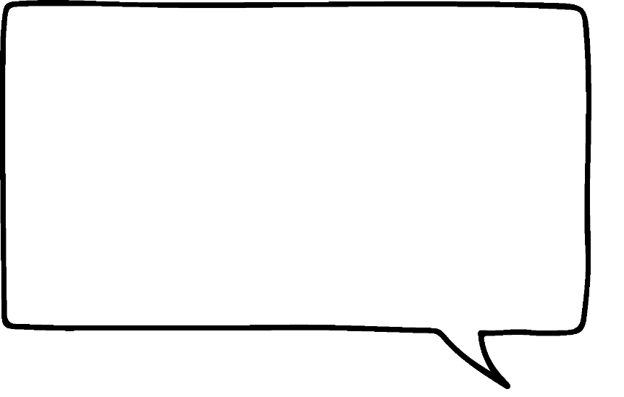
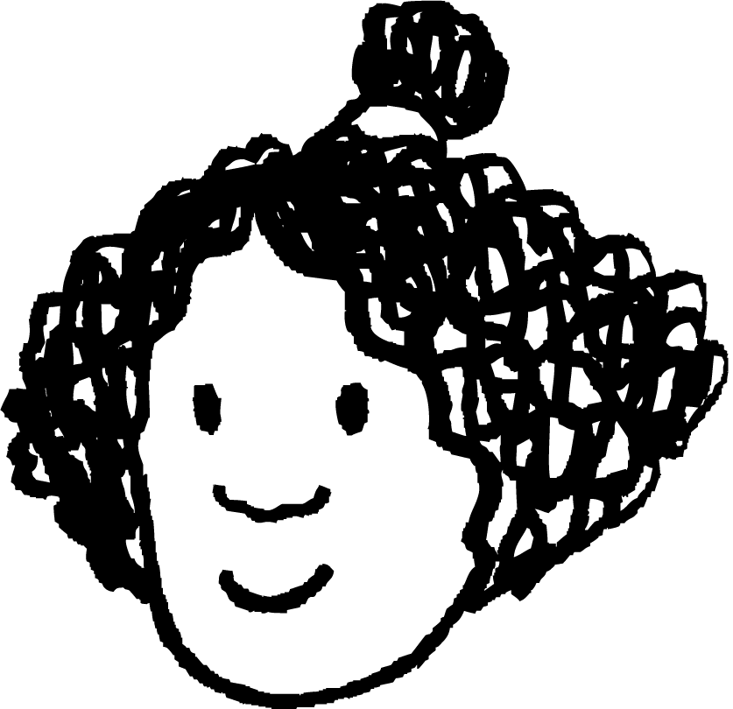
Ratio tables, the unit circle, and tangents
tangent to circle
For different values of θ°, I can record the different lengths of the side opposite θ°.
No matter what, the side adjacent to θ° is still 1 unit.
Izzy
angle (θ°) | length of tangent
40° | 0.84
30° | 0.57
25° | 0.46
length of tangent
adjacent
1 unit
θ°

Slide 7
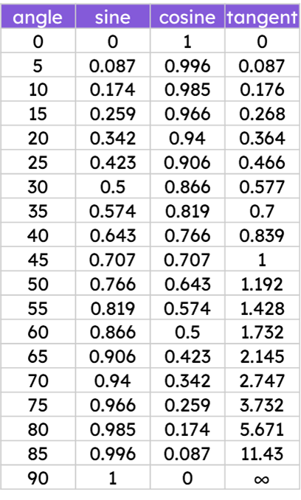
Ratio tables, the unit circle, and tangents
tan
Oh, these numbers look familiar. I’ve just recreated the table of trig values for the tan ratio.
If the length of the side adjacent to an angle is 1 unit, then the side opposite to that angle lies on a tangent to a unit circle.
35
0.7
Izzy
Therefore, we can use the tan ratio on the table of trig values to find the length of the side opposite that angle.
0.7 units
tan(35°)
35°
1 unit

Slide 8
Ratio tables, the unit circle, and tangents
tan
Oh, but it’s also possible to find the length of a side opposite an angle even if the side adjacent to the angle isn’t 1 unit!
I need to sketch a similar triangle with an adjacent side of length 1 unit, and use the tan ratio for that angle.
Izzy
sketch a similar triangle
50
1.192
12.16
cm
1.192
×
10.2
1.192 cm
tan(50°)
50°
50°
10.2 cm
× 10.2
1 cm

Slide 9

Ratio tables, the unit circle, and tangents
tan
A triangle similar to this will be sketched, whose side adjacent to the 55° angle has length of 1 cm.
Using the table of trig values, find the length of the side labelled a.
sketch a similar triangle
55
1.428
a
1.428 cm
55°
55°
20 cm
1 cm

Slide 10
Ratio tables, the unit circle, and tangents
A triangle similar to this will be sketched, whose side adjacent to the 55° angle has length of 1 cm.
By using similar triangles, find the length of the side labelled b.
sketch a similar triangle
b
28.56
cm
1.428 cm
55°
55°
× 20
20 cm
1 cm

Slide 11
Ratio tables, the unit circle, and tangents
tan
It’s also possible to use the tan ratio in order to find the length of a side adjacent to an angle when given the length of the side opposite to it.
opp | adj
0.7
1
×
16
0.7
16
16
x
22.86
0.7
35
0.7
sketch a similar triangle
16
cm
0.7 cm
tan(35°)
35°
35°
x cm
1 cm
22.86 cm
×
16
0.7

Slide 12
Ratio tables, the unit circle, and tangents
tan
Find the length of the side labelled a.
opp | adj
0.466
1
a
25
0.466
sketch a similar triangle
40
cm
0.466
cm
a
25°
25°
x cm
1 cm

Slide 13
Ratio tables, the unit circle, and tangents
tan
What is the scale factor, given as a fraction, from the triangle with an adjacent side of 1 cm to the other?
opp | adj
40
0.466
1
×
0.466
40
25
0.466
sketch a similar triangle
40
cm
0.466
cm
25°
25°
x cm
1 cm
×
40
b
0.466

Slide 14
Ratio tables, the unit circle, and tangents
tan
Hence, find the length of the side labelled x (2 d.p.)
opp | adj
40
0.466
1
×
0.466
40
85.84
25
0.466
sketch a similar triangle
40
cm
0.466
cm
25°
25°
85.84 cm
1 cm
x cm
×
40
0.466

Slide 15
Ratio tables, the unit circle, and tangents
1) Fill in the blanks and ratio table. By considering corresponding sides, find the length of side labelled a cm.
sketch a similar triangle
a cm
tan(15°)
15°
15°
18.5 cm
1 cm
adjacent | opposite
1

Slide 16
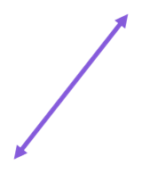
Ratio tables, the unit circle, and tangents
2) By sketching similar triangles, find the length of the missing side for each triangle.
sketch a similar triangle
60
cm
65°
b cm
×
d cm
18.5
cm
50°
c cm
40°
0.88
cm

Slide 17
Ratio tables, the unit circle, and tangents
1) Fill in the blanks and ratio table. By considering corresponding sides, find the length of side labelled a cm.
sketch a similar triangle
a cm
tan(15°)
15°
4.958 cm
15°
0.268
18.5 cm
1 cm
adjacent | opposite
1 | 0.268
18.5 | 4.958
× 18.5

Slide 18
Ratio tables, the unit circle, and tangents
2) By sketching similar triangles, find the length of the missing side for each triangle.
sketch a similar triangle
60
cm
65°
b = 128.7
b cm
×
60
d cm
18.5
cm
50°
c = 1.04896
d = 22.05
c cm
40°
0.88
cm

Slide 19
Tangent ratio
Ratio tables, the unit circle, and tangents
The opposite and the adjacent
Effectively using a calculator for the tan ratio

Slide 20
The opposite and the adjacent
The side opposite an angle (of size θ°) in a right-angled triangle is always tan(θ°) multiplied by the length of the side adjacent to that same angle.
I wonder if there’s a similar relationship between the opposite and adjacent sides of a triangle and the tangent ratio.
Izzy
adj
× tan(θ°)
= opp
opp
adj × tan(θ°) cm
θ°
adj

Slide 21
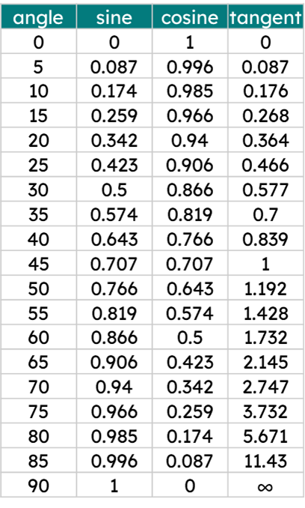
The opposite and the adjacent
opposite side = adj × tan(θ°)
By using this relationship, find the values that should go in these gaps.
opposite side = × tan( )
68
80
a
b
opposite side
Hence, find the length of the side opposite the angle 80°.
80°
385.628 cm
68 cm

Slide 22
The opposite and the adjacent
It is also possible to find the length of the adjacent if we know:
the size of the angle the side is adjacent to
the length of the side opposite this angle
We can do this by substituting known values in the triangle, and rearranging the equation we end up with.
opposite side = adj × tan(θ°)
78
= adj × tan(30°)
78 cm
78
= adj × 0.577
0.577
0.577
30°
78
= adj
= 135.18
h cm
135.18 cm
0.577

Slide 23
The opposite and the adjacent
By using this relationship, find the values that should go in these gaps.
opposite side = adj × tan(θ°)
= adj × tan( )
105
75
a
b
Knowing that tan(75) has a value of 3.732, what value goes into these gaps?
105 cm
105 = adj × tan( 75 )
3.732
3.732
c
d
75°
Hence, what is the length of the side adjacent to the 75° angle?
adj
28.135 cm

Slide 24
The opposite and the adjacent
1) Find the length of the side opposite the labelled angle using this relationship.
opposite side = adj × tan(θ°)
a)
adj × tan(θ°) cm
h × tan( θ° ) cm
h × sin( θ° ) cm
40°
91 cm

Slide 25
The opposite and the adjacent
1) Find the length of the side opposite the labelled angle using this relationship.
opposite side = adj × tan(θ°)
b)
h × tan( θ° ) cm
35°
16.9 cm
c)
d)
55°
d cm
adj × tan(θ°)
20°
143
cm
0.44 cm

Slide 26
The opposite and the adjacent
2) Find the length of the adjacent when given the side opposite the labelled angle.
opposite side = adj × tan(θ°)
b)
66 cm
65 cm
a)
88 cm
80°
10°
adj
adj = opposite side
adj =
0.176

Slide 27
The opposite and the adjacent
2) Find the length of the adjacent when given the side opposite the labelled angle.
opposite side = adj × tan(θ°)
d) A right-angled triangle has an angle of 85°.
The length of the side opposite this angle is 142 cm.
c)
65°
202 cm
adj
183 cm

Slide 28
The opposite and the adjacent
1) Find the length of the side opposite the labelled angle using this relationship.
opposite side = adj × tan(θ°)
a)
adj × tan(θ°) cm
b)
h × tan( θ° ) cm
h × tan( θ° ) cm
16.9
35
91
40
h × sin( θ° ) cm
91
0.839
40°
35°
= 11.83 cm
= 76.349 cm
16.9 cm
91 cm
c)
d)
d = 0.16016 cm
55°
d cm
adj × tan(θ°)
20°
143 cm
= 204.204 cm
0.44 cm

Slide 29
The opposite and the adjacent
2) Find the length of the adjacent when given the side opposite the labelled angle.
opposite side = adj × tan(θ°)
a)
b)
88 cm
66 cm
65 cm
10°
adj = opposite side
65
= 500 cm
adj =
80°
0.176
5.671
adj
= 11.46 cm
c)
d) A right-angled triangle has an angle of 85°.
The length of the side opposite this angle is 142 cm.
65°
202 cm
adj
= 85.31 cm
= 12.42 cm
183 cm

Slide 30
Tangent ratio
Ratio tables, the unit circle, and tangents
The opposite and the adjacent
Effectively using a calculator for the tan ratio

Slide 31
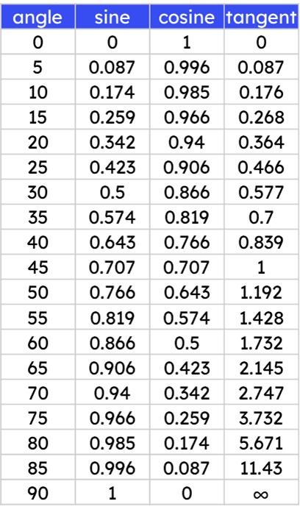
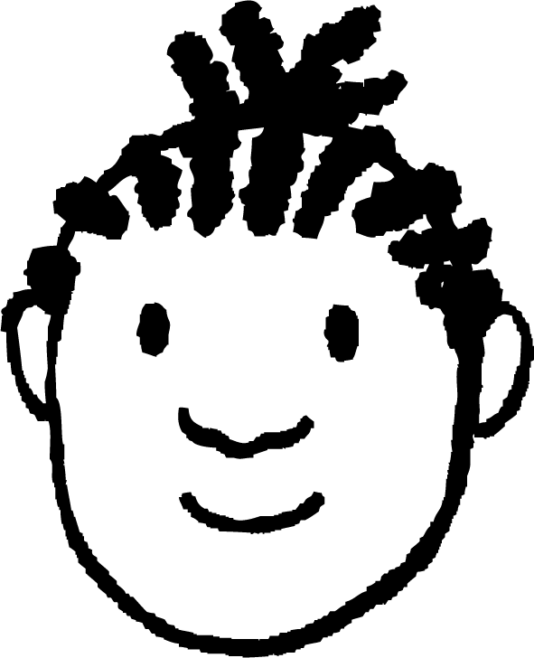
Effectively using a calculator for the tan ratio
I cannot rely on the table for this triangle, as tan(61°) isn’t in table.
Guess I’ll use a calculator.
Jacob
61°
100 cm
k cm
Typing tan(61°) into the calculator gives…
100
× tan(61°)
100
× 1.804047755
= 180.4047755

Slide 32
Effectively using a calculator for the tan ratio
Typing out 1.804047755 again is such a pain.
Is there a quicker way of using the calculator?
Jacob
61°
100 cm
k cm
Typing tan(61°) into the calculator gives…
100
× tan(61°)
100
× 1.804047755
= 180.4047755

Slide 33
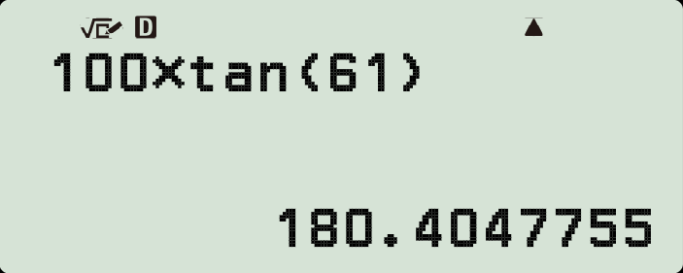

Effectively using a calculator for the tan ratio
Before using your calculator, check that it is in degrees mode (D).
Length of the adjacent
Multiplied by
61°
the tan ratio (the open bracket is automatically written)
100 cm
of the adjacent angle (you must write the close bracket yourself).
100
× tan(61°)

Slide 34
Effectively using a calculator for the tan ratio
So it’s easy to use a calculator to find the length of the opposite side if you know the adjacent side…
But finding the length of the adjacent is going to be more tricky, since there’s a division involved, right?
Jacob
64°
= 45
k cm
k
× tan(64°)
= 45
× tan(64°)
× tan(64°)
× tan(64°)
45 cm
= 45
k
=
× tan(64°)

Slide 35
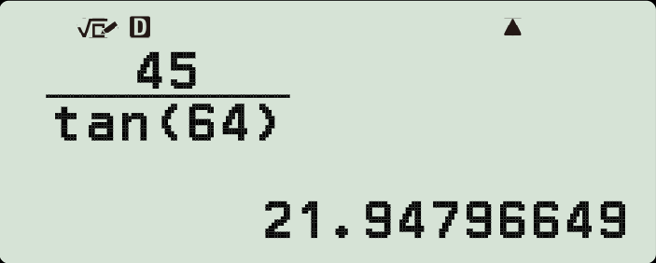

Effectively using a calculator for the tan ratio
Start with the fraction button so it is clear what you need to put on the numerator and denominator.
64°
= 45
× tan(64°)
The opposite side,
divide by
45 cm
the tan ratio of the opposite angle.

Slide 36
Effectively using a calculator for the tan ratio
Match the triangle to the calculation that finds the length of its missing side.
a
42°
b
42°
x cm
200 cm
x cm
200 cm
200
tan(42°)
x =
x =
x = 200 × tan(42°)
tan(42°)
200
e
c
d

Slide 37

Effectively using a calculator for the tan ratio
Match the triangle to the calculation that finds the length of its missing side.
a
42°
b
42°
180.08 cm
x cm
200 cm
222.12 cm
x cm
200 cm
x = 200 × tan(42°)
200
x =
e
tan(42°)
c
Hence, use a calculator to find the length of each missing side labelled with an x (2 d.p.)
tan(42°)
x =
200
d

Slide 38
Effectively using a calculator for the tan ratio
1) Starting with the smallest, put these side lengths of right-angled triangles in order of size.
0.4
50
50 × tan(70°)
tan(10°)
tan(70°)
0.4 × tan(10°)
0.4 × tan(70°)
0.4
50 × tan(45°)
tan(70°)

Slide 39
Effectively using a calculator for the tan ratio
2) Find the lengths of all missing sides labelled with a letter (3 d.p.)
a)
b)
c)
a cm tan(33°)
b cm
48°
c cm
33°
42°
1 cm
1 cm
1 cm
d)
e)
f)
d cm
e cm
42 cm
42°
19°
19°
19 cm
42 cm
f cm

Slide 40
Effectively using a calculator for the tan ratio
1) Starting with the smallest, put these side lengths of right-angled triangles in order of size.
0.4 × tan(10°)
0.4 × tan(70°)
0.4
0.4
0.071
tan(70°)
1.099
tan(10°)
0.146
2.269
50 × tan(70°)
50 × tan(45°)
50
137.374
50
tan(70°)
18.199

Slide 41
Effectively using a calculator for the tan ratio
2) Find the lengths of all missing sides labelled with a letter (3 d.p.)
a)
b)
c)
a cm tan(33°)
b cm
48°
c cm
33°
42°
1 cm
1 cm
1 cm
a = 0.649
b = 0.900
c = 0.900
d)
e)
e = 14.462
f)
f = 121.977
d cm
e cm
42 cm
42°
19°
19°
19 cm
42 cm
f cm
d = 17.108

Slide 42
Tangent ratio
The length of any side opposite or adjacent to an angle (θ°) in a right-angled triangle from the unit circle can be found using a table of trig values including the tan ratio. This triangle can be enlarged and this will still be true.
The length of the side opposite to any angle (θ°) in a right-angled triangle is equal to adjacent × tan(θ°).
A calculator can be used to find the length of either the opposite or adjacent side of a right-angled triangle if the other one is known.

Slide 43

© Oak National Academy 2024.
Produced in partnership with Mathematics in Education and Industry.
Licensed on the Open Government Licence v3.0, except where otherwise stated. See Oak terms and conditions.

